Slide 1
Team Programming: Making a Coaster

Slide 2
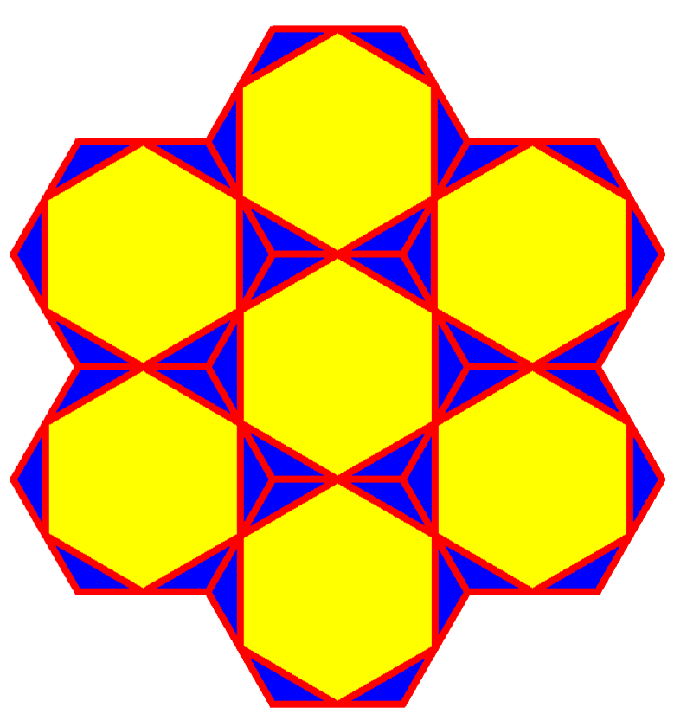
The Coaster
(your color choices please)

Slide 3

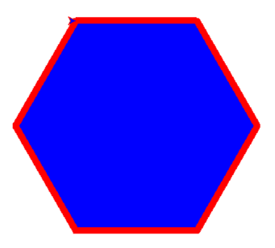

Slide 4

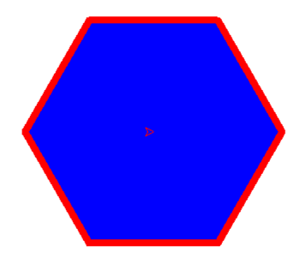

Slide 5

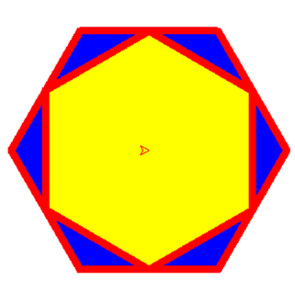

Slide 6

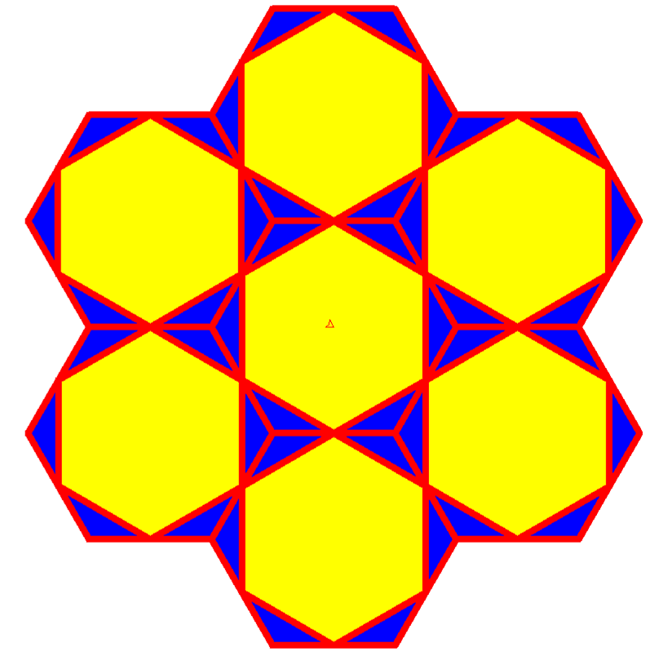

Slide 7
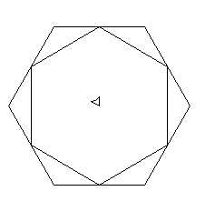
Write functions to find y and x in terms of sz.
sz
y
A
x

Slide 8
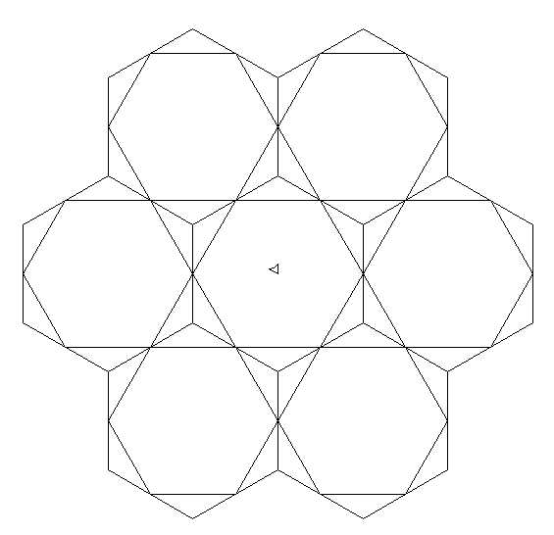
Write a function to find d in terms of sz
sz
d

